Slide 1


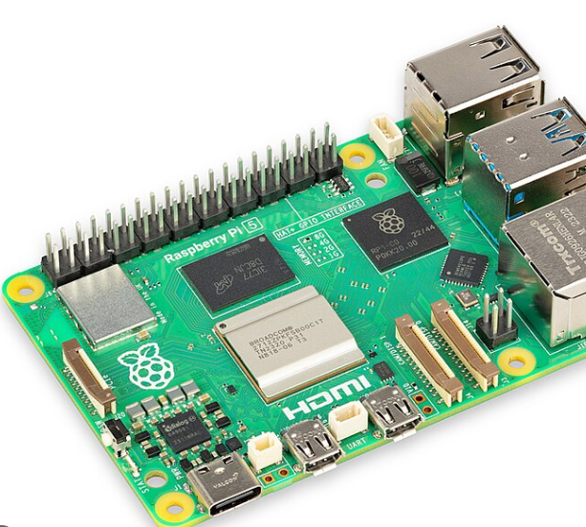
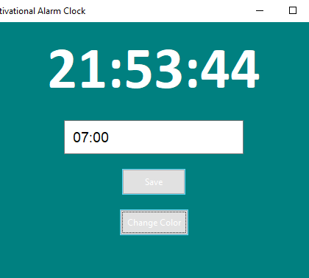
Motivational Alarm Clock
By: Grayson Glazier
“Rise and shine! A new day awaits.”
“You’ve got this! Time to conquer the day.”
“Today is full of possibilities. Make it count!”
Need help getting out of bed? Try this motivational alarm clock! With the use of a raspberry pi and some coding this alarm clock will wake you up with a standard alert sound AND displays a motivational quote that changes day to day! Get inspiration as soon as you open your eyes!
“Wake up with determination. Go to bed with satisfaction.”
https://github.com/ksu-is/Motivational-Alarm-Clock

